Slide 1







Technology Trends & Analysis Presentation
Yasir Savanur
23/04/2022

Slide 2



OUTLINE
Executive Summary
Introduction
Methodology
Results
Visualization – Charts
Dashboard
Discussion
Findings & Implications
Conclusion
Appendix

Slide 3

EXECUTIVE SUMMARY
Trends in Programming Languages and Databases
Demographics Survey
Technological gap in different countries
Gender gap in different countries

Slide 4

INTRODUCTION
About: Analysing the trends in software development
Purpose:
Identify skill requirements for future
What are the top programming languages in demand?
What are the top database skills in demand?
What are the popular IDEs?
Audience: Human Resource and IT Head

Slide 5

METHODOLOGY
Data Collection Sources
Stack Overflow Developer 2019 Survey
GitHub Job Postings
Programming Languages Annual Salary
Data Exploration
Data Cleaning
Data Visualization
Presentation

Slide 6
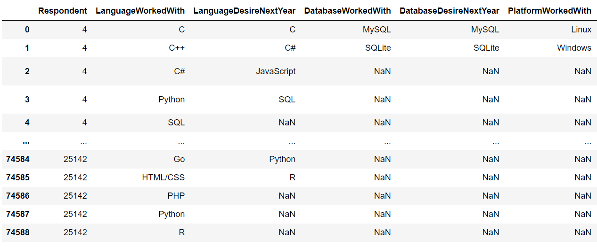
RESULTS
Results are based on this table:

Slide 7
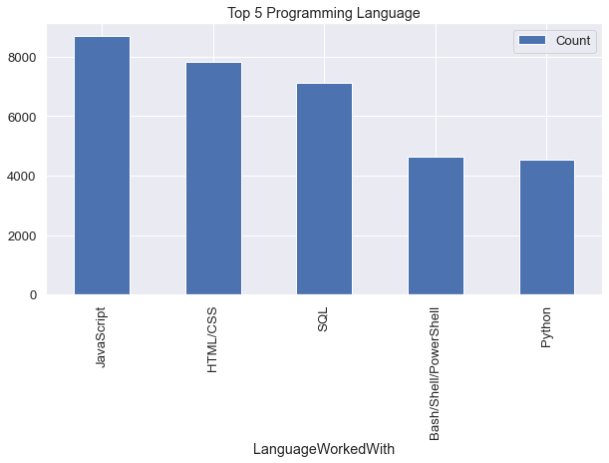
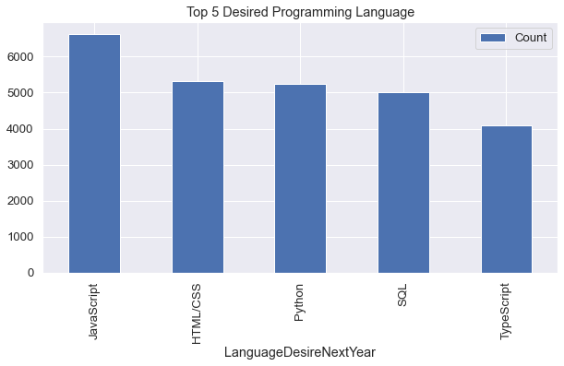
PROGRAMMING LANGUAGE TRENDS
Current Year
Next Year

Slide 8
PROGRAMMING LANGUAGE TRENDS - FINDINGS & IMPLICATIONS
Findings
JavaScript, HTML/CSS, SQL are top 3 this year
Python and Typescript are becoming popular next year
PowerShell edged out in next year
Implications
Web development is still in high demand
Big Data technology in companies still require SQL
With AI and ML rising in demand, Python is the best choice

Slide 9
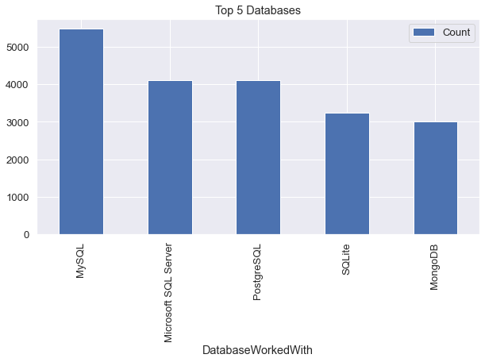
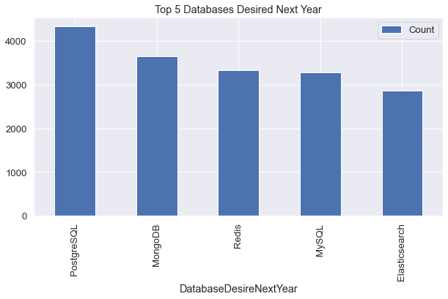
DATABASE TRENDS
Current Year
Next Year

Slide 10
DATABASE TRENDS - FINDINGS & IMPLICATIONS
Findings
MySQL is the most popular
Followed by Microsoft SQL
MongoDB and Redis are upcoming favorites
New kid on the block: Elasticsearch
Implications
Open-source databases are still preferable in companies
NoSQL databases will make an impact for storing non-relational data
Redis supports abstract data types
Pre-tuned search to website, app, or ecommerce store

Slide 11

DASHBOARD
IBM COGNOS DASHBOARD EMBEDDED URL
https://eu-gb.dataplatform.cloud.ibm.com/dashboards/080db4b4-7cd8-40fe-963f-8aafe714847d/view/5b00c3762cb23efc52efc4e407cb2b02753e730fbabbd001878d7b495b327397f06d1099c828195adb470166a5b9105fcd

Slide 12
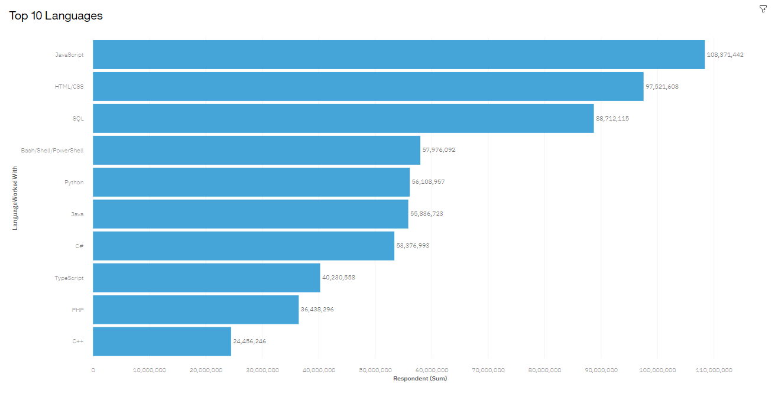
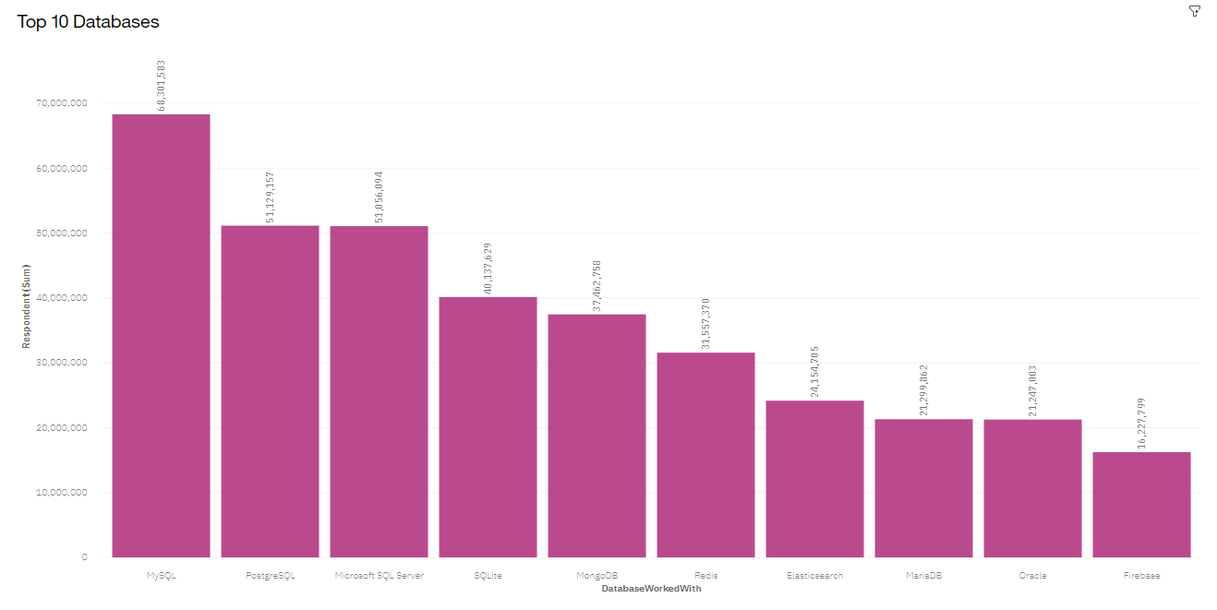
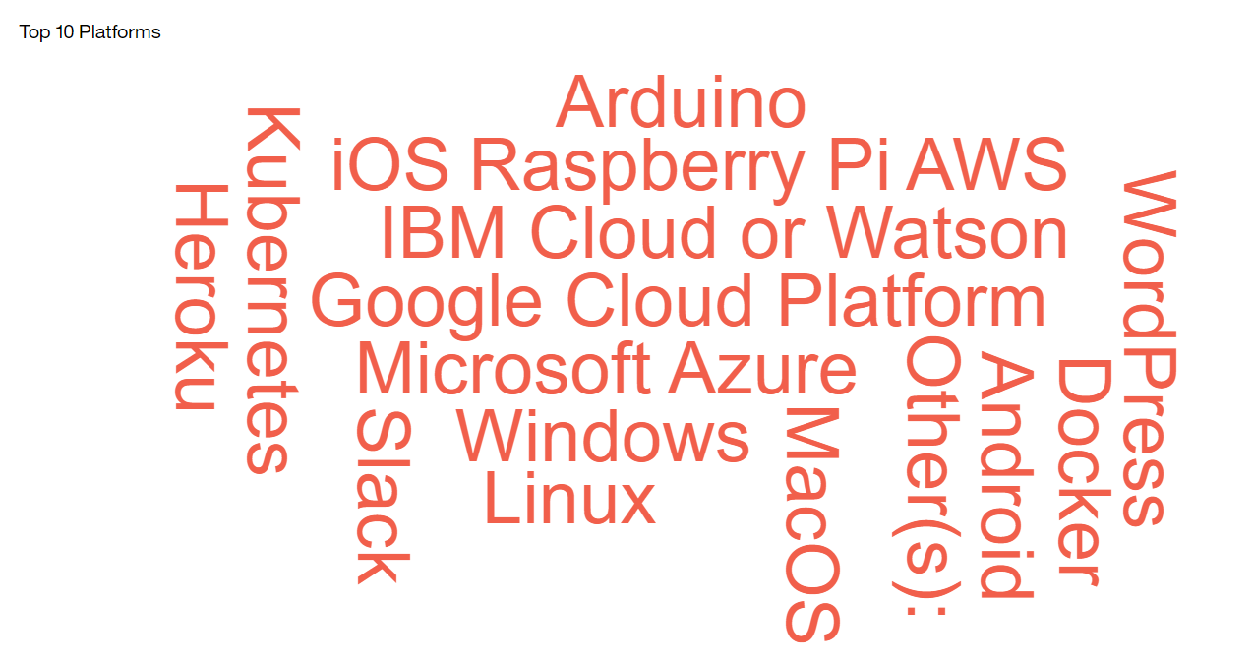
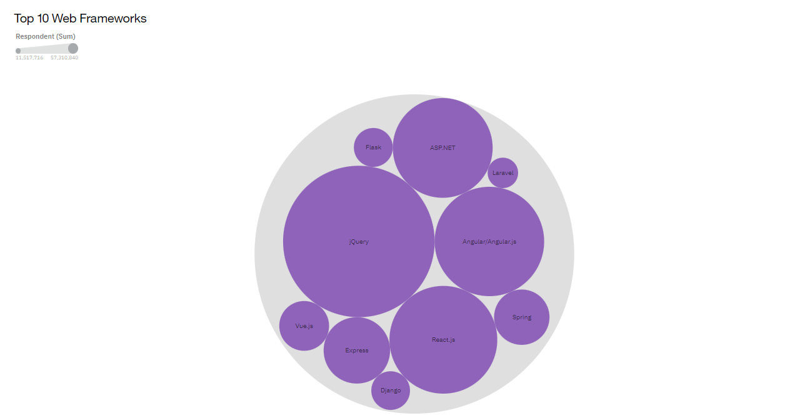
DASHBOARD - CURRENT TECHNOLOGY USAGE

Slide 13
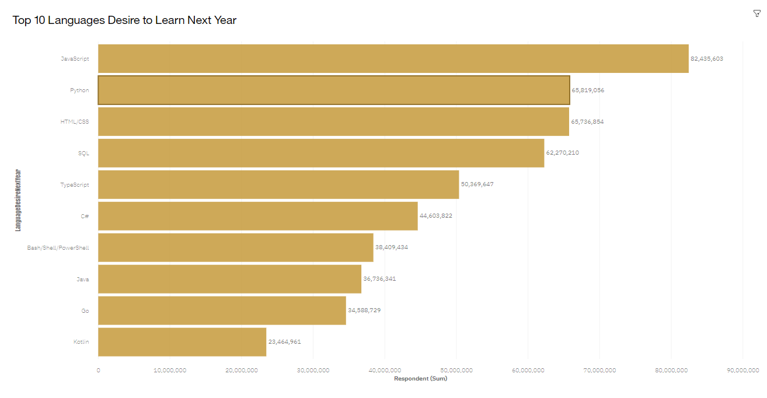
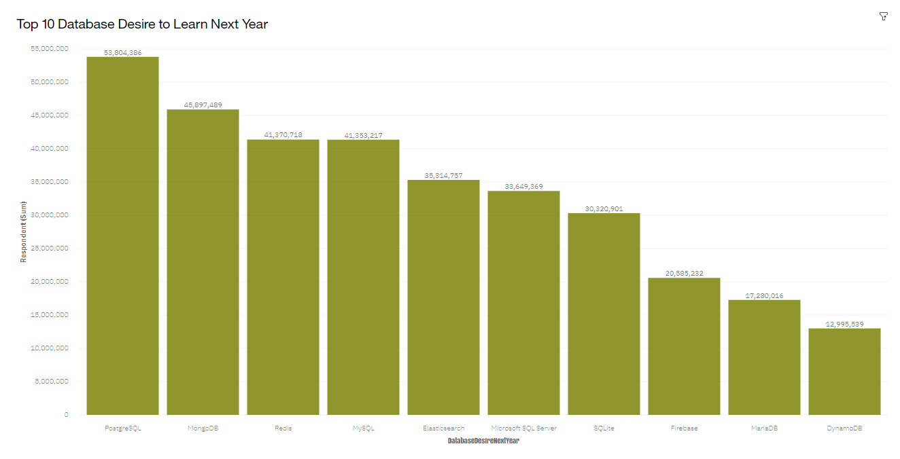
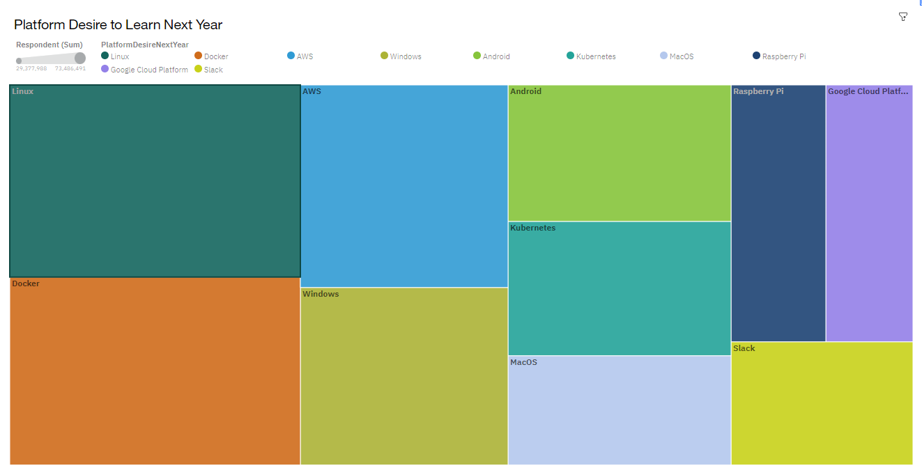
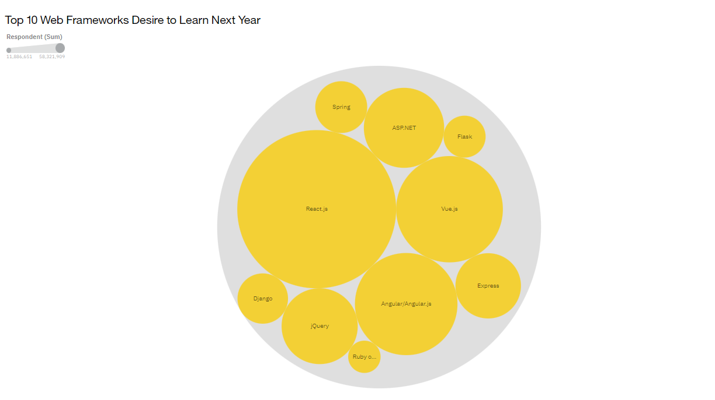
DASHBOARD – FUTURE TECHNOLOGY TREND

Slide 14
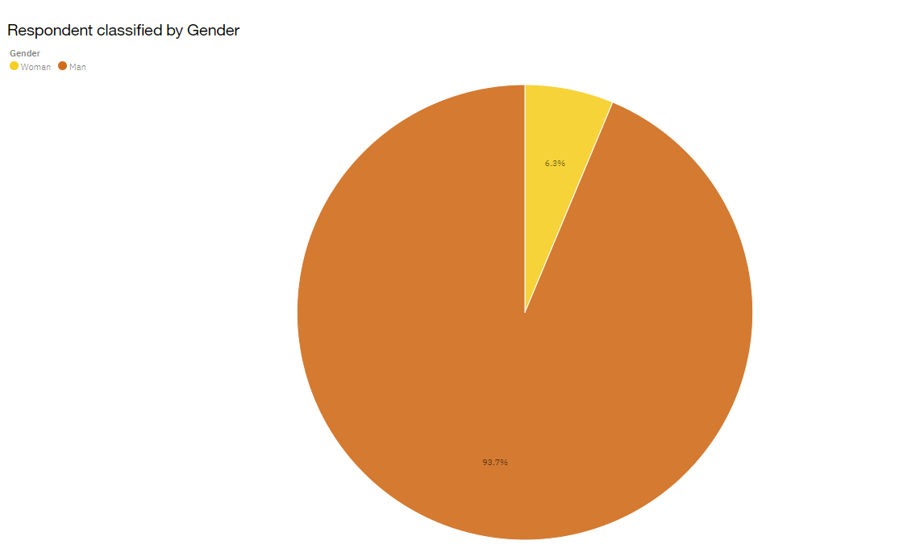
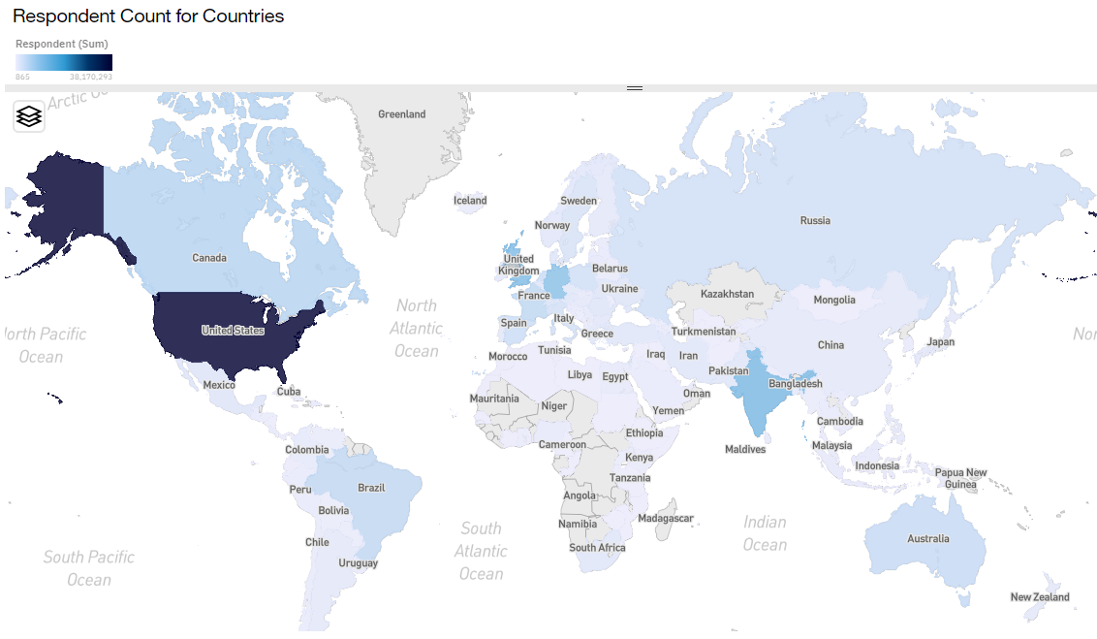
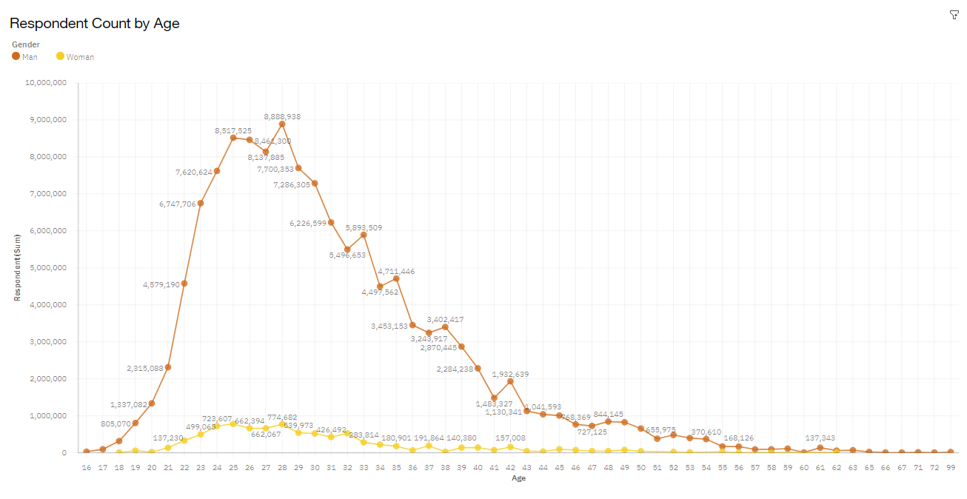
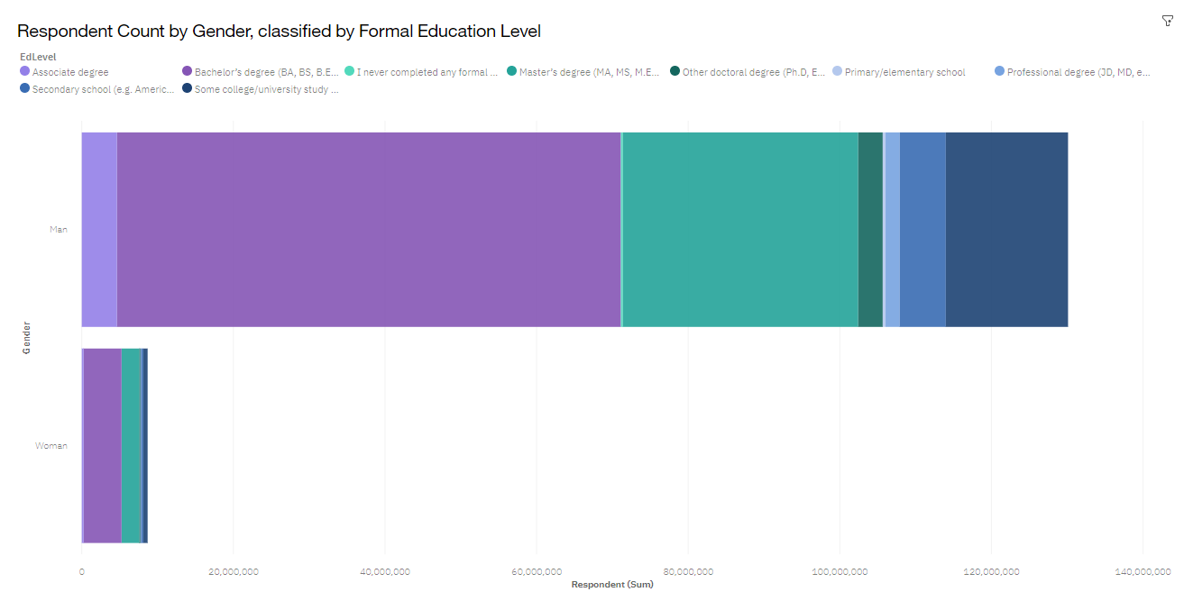
DASHBOARD - DEMOGRAPHICS

Slide 15
DISCUSSION
No significant difference in Technology trends between now and future
Training and Reskilling workers is essential
More female participation in Technology field should be enforced
Bridge technology gaps in developing countries
Eliminate age and education discrimination in employment

Slide 16
OVERALL FINDINGS & IMPLICATIONS
Findings
Fast changing technology every year
Concentration on several countries such as the US, UK & India
Gender gap in technology jobs
Platforms like Docker and AWS are growing
Implications
Companies need to be flexible and adjust to rapid changes
Need to spread technology out to lagging countries
Impact of job hiring’s
Shift to faster app deployments and cloud services in future

Slide 17

CONCLUSION
Technology Trends for current and next year
Programming Languages, Database and Platform overview
Demographics overview
Actions to be taken
In future, incorporate Machine Learning to predict trends and salaries

Slide 18

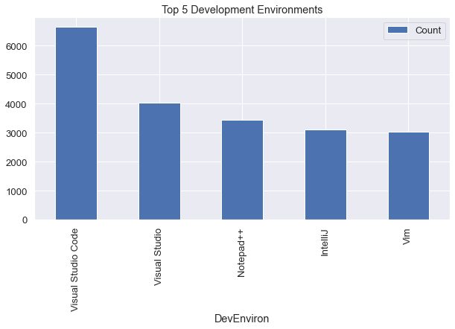
APPENDIX

Slide 19
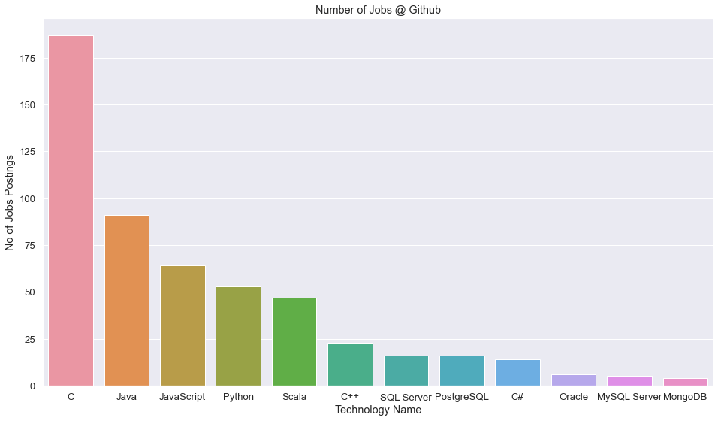
GITHUB JOB POSTINGS

Slide 20
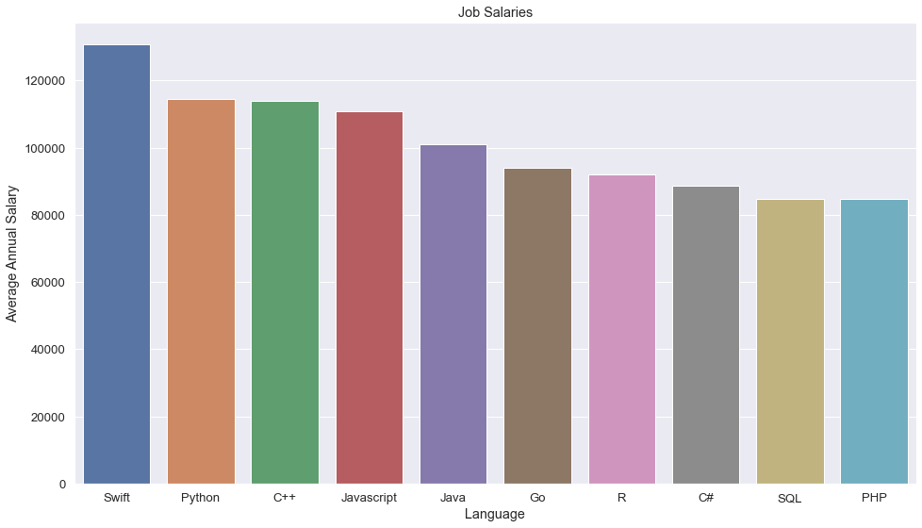
POPULAR LANGUAGES BY SALARY

